Slide 1
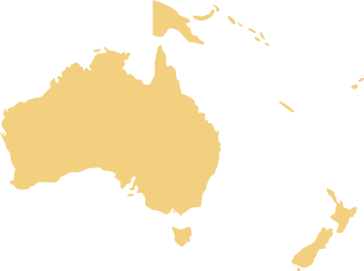
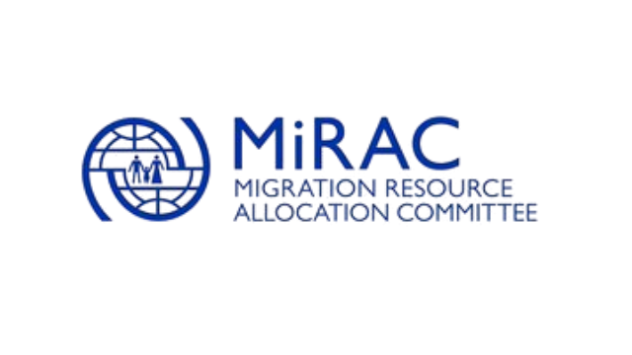
Migration Data in Oceania
Regional Overview Launch Event
15 January, 12:00 – 13:00 FJT
*The Global Migration Data Portal has been made possible through funding by IOM Member States, including the Government of Germany through the Federal Ministry of the Interior, Building and Community, represented by the Federal office for Migration and Refugees (BAMF), and the Government of Switzerland, as well as unearmarked funding granted to IOM and internally allocated through the Migration Allocation Resource Committee (MIRAC).

Slide 2
Opening Remarks
Pär Liljert, Chief of Mission
IOM Australia; Coordinator and Advisor for
New Zealand, Papua New Guinea and the Pacific
*The Global Migration Data Portal has been made possible through funding by IOM Member States, including the Government of Germany through the Federal Ministry of the Interior, Building and Community, represented by the Federal office for Migration and Refugees (BAMF), and the Government of Switzerland, as well as unearmarked funding granted to IOM and internally allocated through the Migration Allocation Resource Committee (MIRAC).

Slide 3
Global Migration Data Portal*
Dr. Susanne Melde, Senior Analyst
IOM’s Global Migration Data Analysis Centre (GMDAC)
*The Global Migration Data Portal has been made possible through funding by IOM Member States, including the Government of Germany through the Federal Ministry of the Interior, Building and Community, represented by the Federal office for Migration and Refugees (BAMF), and the Government of Switzerland, as well as unearmarked funding granted to IOM and internally allocated through the Migration Allocation Resource Committee (MIRAC).

Slide 4
Global Migration Data Portal
Challenge: Migration data are scattered between various institutions and countries
Proposed on 12 July 2016 by then German Foreign Minister Steinmeier and IOM's former DG Swing
Launched on 15 December 2017
Mentioned in the final text of the Global Compact for Migration as a repository for data
Berlin, July 12, 2016
*The Global Migration Data Portal has been made possible through funding by IOM Member States, including the Government of Germany through the Federal Ministry of the Interior, Building and Community, represented by the Federal office for Migration and Refugees (BAMF), and the Government of Switzerland, as well as unearmarked funding granted to IOM and internally allocated through the Migration Allocation Resource Committee (MIRAC).

Slide 5
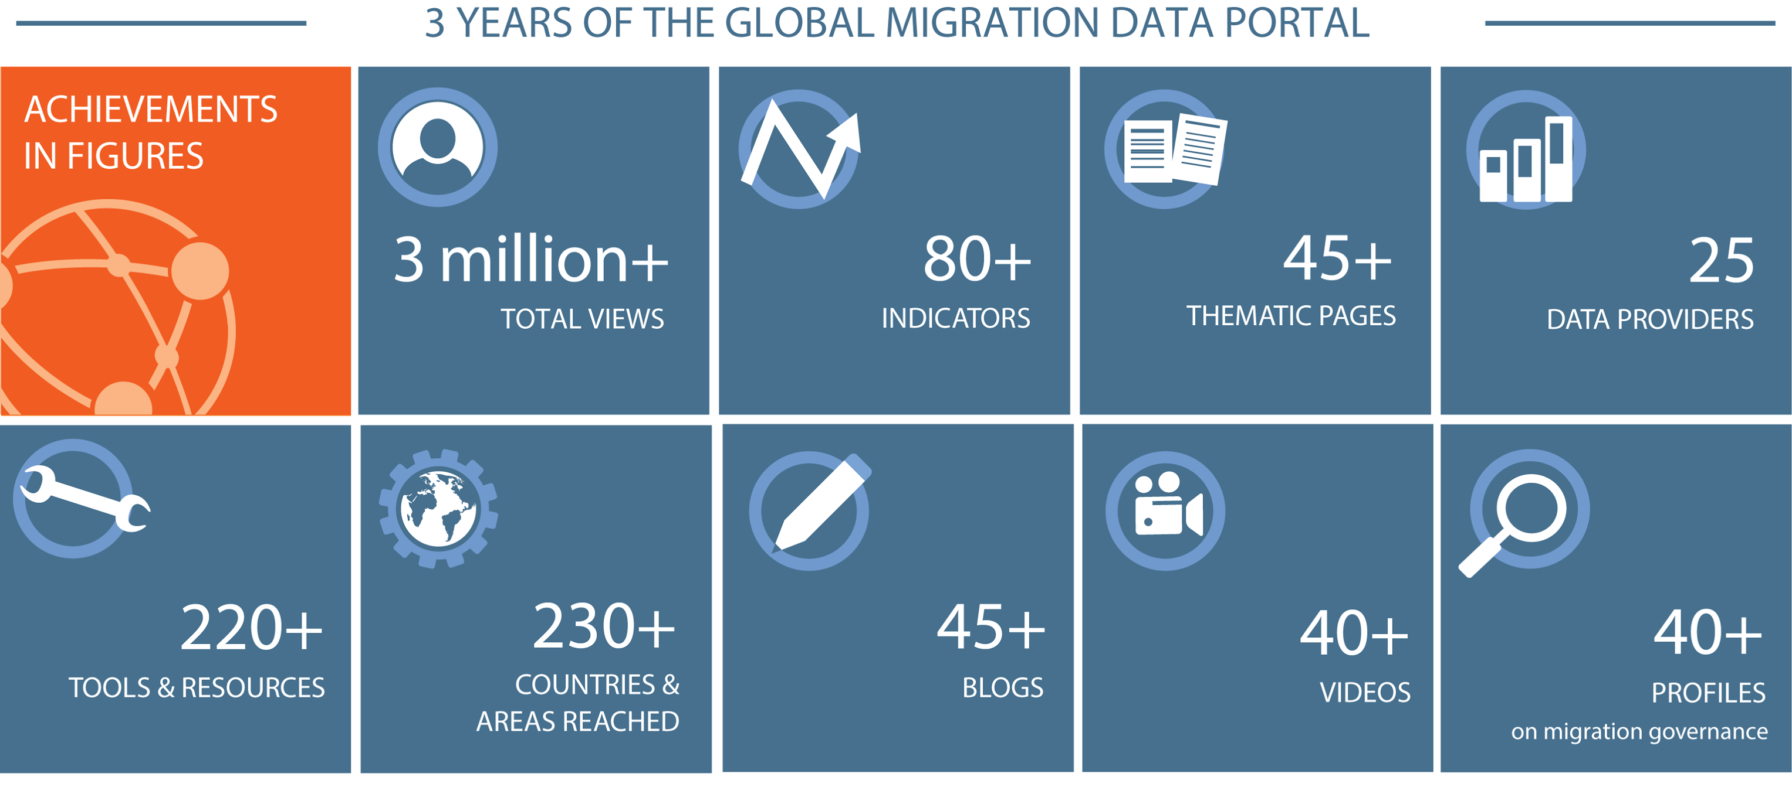
*The Global Migration Data Portal has been made possible through funding by IOM Member States, including the Government of Germany through the Federal Ministry of the Interior, Building and Community, represented by the Federal office for Migration and Refugees (BAMF), and the Government of Switzerland, as well as unearmarked funding granted to IOM and internally allocated through the Migration Allocation Resource Committee (MIRAC).

Slide 6
Susanne Melde, GMDAC Senior Analyst​
smelde@iom.int ​
Global Migration Data Analysis Centre​
Taubenstr. 20-22​
10117 Berlin, Germany​
www.migrationdataportal.org ​
Facebook: @migrationdataportal / Twitter: @IOM_GMDAC​
*The Global Migration Data Portal has been made possible through funding by IOM Member States, including the Government of Germany through the Federal Ministry of the Interior, Building and Community, represented by the Federal office for Migration and Refugees (BAMF), and the Government of Switzerland, as well as unearmarked funding granted to IOM and internally allocated through the Migration Allocation Resource Committee (MIRAC).

Slide 7
Migration Data in Oceania
Dr. Robyn Sampson
Director at Robyn Sampson Consulting
*The Global Migration Data Portal has been made possible through funding by IOM Member States, including the Government of Germany through the Federal Ministry of the Interior, Building and Community, represented by the Federal office for Migration and Refugees (BAMF), and the Government of Switzerland, as well as unearmarked funding granted to IOM and internally allocated through the Migration Allocation Resource Committee (MIRAC).
Notes:
Thank you so much for the opportunity to present the findings regarding migration data in Oceania today. I was honoured to be able to contribute to the Migration Data Portal with an analysis of the trends of this region. Today I will flag the key trends that are elaborated in more detail in the page we are launching today, including the impacts of the current COVID-19 pandemic on migration in Oceania.

Slide 8
Countries of Oceania
Micronesia
Kiribati
the Marshall Islands
Federated States of Micronesia
Nauru
Palau
Polynesia
Samoa
Tonga
Tuvalu
Melanesia
Fiji
Papua New Guinea
Solomon Islands
Vanuatu
Not included in this analysis:
American Samoa
Cook Islands
French Polynesia
Guam
New Caledonia
Niue
Northern Mariana Islands
Tokelau
Wallis and Futuna Islands
Australia and New Zealand
Australia
New Zealand
Notes:
Oceania is comprised of island nations with few shared land borders spread across the Pacific Ocean. Traditionally, the ocean was seen to connect people through a ‘sea of islands’ (Hau’ofa et al., 1993), resulting in the region’s current identity as the ‘Blue Pacific Continent.’ Its 14 countries are grouped into four geopolitical sub-regions, as shown on the screen.
There are nine semi‑autonomous territories in the area that do not maintain representation at the United Nations, and are not included in these analyses.
Migrants represent 25.8 per cent of the 873,000 people in these territories (ibid.).

Slide 9
271.6 million
8.7 million
Notes:
As you can see in this graphic, Oceania hosts only 3.3% of the world’s international migrant population, while Africa hosts 9.8%, the Americas 25.9%, Europe 30.3% and Asia 30.8%.
There are 8.7 million migrants in the region (UN DESA, 2019).
7.5 million of these migrants live in Australia and 1 million in New Zealand.
The remaining 75,369 migrants in the region are dispersed across the Pacific Island countries.

Slide 10
Notes:
So, the 8.7 million people who are migrants in Oceania comprise 21 per cent of the region’s population. This trend is disparate across the countries of the region. The countries with the highest proportion of migrants in their population are Australia (30%), Palau (28%), New Zealand (22%), and Nauru (19%). In contrast, on average migrants represent only 2.2 per cent of the population in the region’s other countries.
However, as a region, Oceania far outstrips its counterparts in terms of migrants as a share of the population.

Slide 11
Notes:
The key point I want you to take away is that Oceania is unique compared with other regions globally. While it hosts a small number of the world’s migrants, these people represent a big share of the region’s population, with migrants comprising 1 in every 5 people in the region!

Slide 12
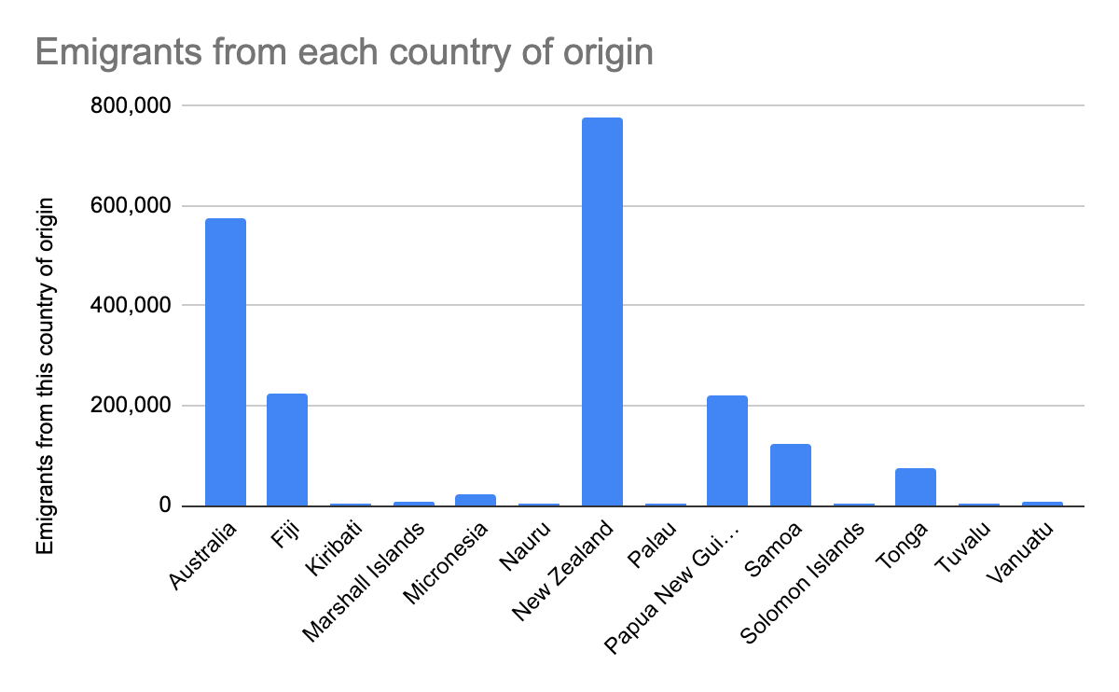
Migrants originating from Oceania
2.049 million people have emigrated from a country in Oceania
Notes:
Just over 2 million of the world‘s migrants originate from a country in Oceania.
Together, migrants from New Zealand, Australia, Fiji and Papua New Guinea account for almost 1.8 million such migrants.

Slide 13
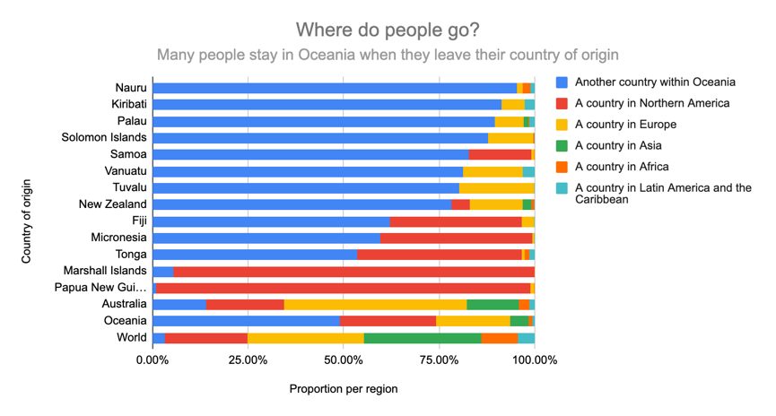
Migrants originating from Oceania
Notes:
Half of the migrants originating from Oceania have relocated to a different country within the region (as indicated in blue).
However, people whose country of origin is Australia are more likely to move away from the region as compared with their regional neighbours.

Slide 14
Past and present trends
Oceania has a long history of human movement, and this history continues to influence migration patterns today
Migration is key to the region’s economy
Seasonal labour schemes facilitate migration from select Pacific countries to fill labour shortages in Australia and New Zealand
A number of resettled refugees live in Oceania
Australia maintains offshore processing arrangements for people who arrive by boat to seek asylum
Notes:
Some of the past and present trends reviewed in the page we launch today include:
Oceania has a long history of human movement, and this history continues to influence current migration patterns
Migration is key to the region’s economy – a point I will return to momentarily
Seasonal labour schemes operated by Australia and New Zealand enable migrants from select Pacific countries to fill labour shortages in certain industries such as agriculture.
The top three countries in the region hosting refugees and asylum seekers are Australia (154,000), Papua New Guinea (9,000) and New Zealand (3,300) (UNHCR, 2020). Annually, Australia and New Zealand offer 18,750 places and 1,500 places respectively to the UNHCR’s refugee resettlement programme.
Meanwhile, Australia maintains offshore processing arrangements for people who arrive by boat to seek asylum.

Slide 15
Recent trends
‘Brain drain’ versus remittance gain
‘Brain drain’ refers to the depletion of human capital in a sector or occupation in one country due to the emigration of skilled workers from those occupations to another country.
Remittances are personal monetary transfers made by migrants to individuals or communities with whom they have links.
Anticipating climate-induced and environmentally-induced migration
A regional framework is under consideration, with the support of the Pacific Climate Change Migration and Human Security Programme
Notes:
And now I turn to the more dominant trends in recent times.
A key recent trend is the tense dance between ‘brain drain’ and remittance gain in the region. For many Pacific Island countries, the emigration of workers can cause shortages in key professions, but such migration can also result in the benefit of remittances and new skills amongst returnees. Notably, remittances account for at least 10 per cent of Gross Domestic Product in four countries in this region, including 37.6 per cent of Tonga’s GDP – which is the highest of any country in the world (World Bank, 2020b).
Another key trend is found in anticipating climate-induced and environmentally-induced migration. Many of the countries of Oceania are acutely vulnerable to the impacts of environmental and climate change. While planned relocation is the least preferred option to respond to these challenges (Gharbaoui and Blocher, 2018), governments agree that migration linked to adverse climate impacts will become more common as disasters become more severe and impacted territories become uninhabitable (McMichael et al., 2019). A regional framework is under consideration (IOM, 2020a), with the support of the Pacific Climate Change Migration and Human Security Programme (IOM, 2019). A landmark decision from the UN Human Rights Committee (2020) recognises that States shall refrain from sending people back to situations in which the impacts of climate change in the country of origin pose a risk to their life with dignity (principle of non-refoulement). The Committee’s conclusions underscore the urgency for States to open new regular migration pathways and provide temporary and longer-term forms of protection to people who would face life-threatening climate risks in case of return to their country of origin. The decision also highlights that the affected States need the support of the international community to address the immense challenges posed by climate change (IOM, 2020b).

Slide 16
The impact of COVID-19 on migration in Oceania
Border restrictions have caused a sudden and dramatic drop in international migration
This is having a substantial impact on the region’s economy as a result of the impacts on:
Tourism
International students
Seasonal labourers
Remittances
Image: lsi.umich.edu
Notes:
And the biggest recent trend of all! I’m sure we are all well aware of many of the restrictions on human movement that have been introduced in an attempt to reduce the spread of COVID-19 both across the world and in this region, such as border closures, restrictions on transportation options, and stringent quarantine measures. As a result, there has been a dramatic drop in international migration.
While these responses have reduced transmission, this has come at tremendous cost. The region’s economy is heavily dependent on international tourism. For example, Fiji’s visitor numbers are down by approximately 80,000 per month, with tourism earnings drastically reduced. Meanwhile, Australia and New Zealand have been hard hit by the lack of international students (Australian Bureau of Statistics, 2020; New Zealand Government, 2020) and seasonal labourers (Australian Department of Home Affairs, 2020a; Immigration New Zealand, 2020).

Slide 17
The impact of COVID-19 on migration in Oceania
Migrants are affected due to:
Becoming ‘stranded’
Separation of families
Loss of work
Loss of the right to work
Image: lsi.umich.edu
Notes:
Thousands of migrants in Oceania have now lost their jobs due to the economic downturn, or lost their right to work due to the expiry of their original visa (Australian Red Cross, 2020).
The Australian Red Cross provided emergency support to almost 30,000 migrants between 1 April and 30 June 2020, and found the key issues accessing the relief were financial insecurity, housing insecurity, gaps in health care and access to health care, and deterioration in mental health.
The World Bank (2020a) reports remittances are dropping due to rising unemployment and inability to travel or work abroad, with an estimated 10.5 per cent decline in East Asia and the Pacific (ibid.).
For those Pacific countries with a high level of remittances, this impact will have serious and long-lasting impacts.

Slide 18
The impact of COVID-19 on migration in Oceania
Low case loads have enabled some border re-openings in the region
Ongoing outbreaks of COVID-19 in the region will continue to impede any return to previous migration patterns for the near future
Image: lsi.umich.edu
Notes:
Due to low caseloads, some countries were starting border re‑openings. As of 24 October 2020, New Zealanders could travel to four states within Australia, and were not required to quarantine on arrival (Australian Department of Home Affairs, 2020b). However, Australians could not yet travel to New Zealand (ibid.). The five COVID-free countries in Micronesia were also working towards a similar “travel bubble” (Palau Government, 2020a).

Slide 19
Notes:
It seems somewhat appropriate to be presenting this to you on an online platform, a contrast to the many times I have been able to meet with people in person to discuss and explore migration issues. Our current circumstances are certainly creating new and unexpected changes to our ways of living and working. But the legacy of migration in Oceania is so well founded that it is likely we will see a quick re-ignition of pre-existing migration trends in the region when it can be done in a safe and orderly manner.
I hope when that time comes, I have an opportunity to meet some of you in person as we continue to work on this important and vital matter for our region!

Slide 20
Thank You!
https://migrationdataportal.org/regional-data-overview/oceania
Contact us: Migrationdataportal@iom.int​
Facebook: @migrationdataportal / Twitter: @IOM_GMDAC​
IOM Global Migration Data Analysis Centre (GMDAC)​
Taubenstr. 20-22​
10117 Berlin, Germany​
*The Global Migration Data Portal has been made possible through funding by IOM Member States, including the Government of Germany through the Federal Ministry of the Interior, Building and Community, represented by the Federal office for Migration and Refugees (BAMF), and the Government of Switzerland, as well as unearmarked funding granted to IOM and internally allocated through the Migration Allocation Resource Committee (MIRAC).

